Slide 1
Cutting Edge Surveillance
CS420 Paul Mitchell

Slide 2
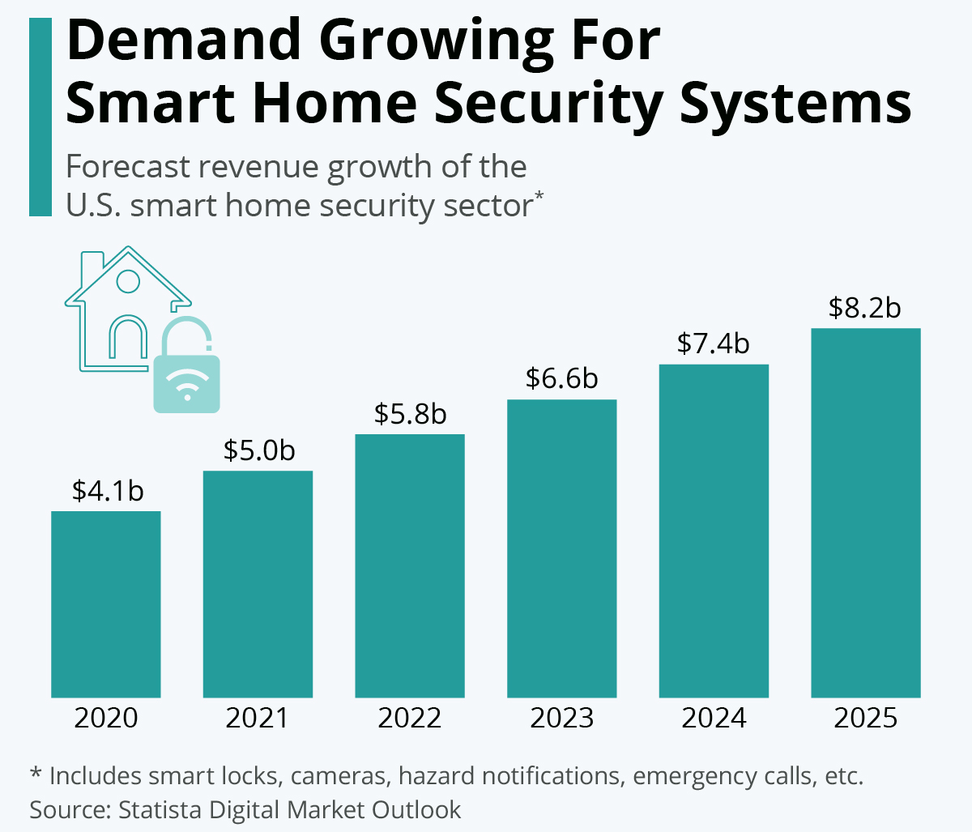
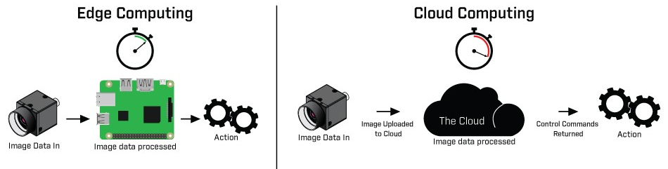
Significance & Motivation
Modern Security Challenges: Edge computing counters evolving threats with advanced, localized analysis capabilities.
Market Alignment: Reflects consumer demand for intelligent, real-time security solutions, driving technological innovation.
Operational Efficiency and Privacy: Local processing minimizes cloud dependency, enhancing data security and system performance.

Slide 3
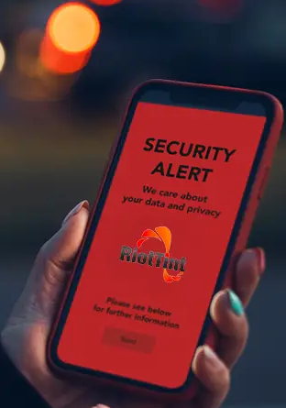
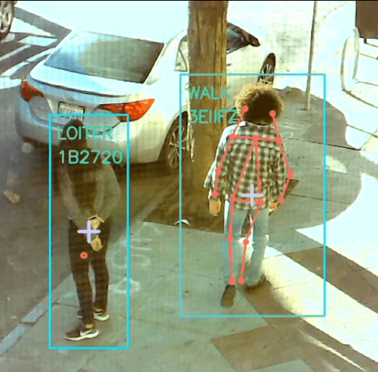

Applications of Edge Computing in Home Security
Instant Alert
Systems
Smart
Surveillance
Network
Efficiency
Immediate response to security breaches
Reduces incident resolution time.
Real-time facial recognition
Abnormal activity detection
Analysis directly on cameras
Minimizes data sent to the cloud
Reduces bandwidth use
Enhances system performance.

Slide 4
My Objectives
Primary Research Question
Can edge computing be effectively leveraged for person profile detection for home security?
Subsidiary Research Question 1 (reliability)
Is Support Vector Machine facial recognition sufficiently accurate for real-time surveillance on edge computing devices?
Subsidiary Research question 2 (speed comparison)
How does the processing latency of SVM facial recognition on edge devices compare to cloud-based implementations?

Slide 5
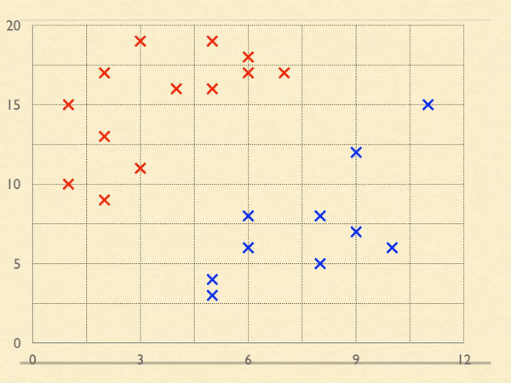
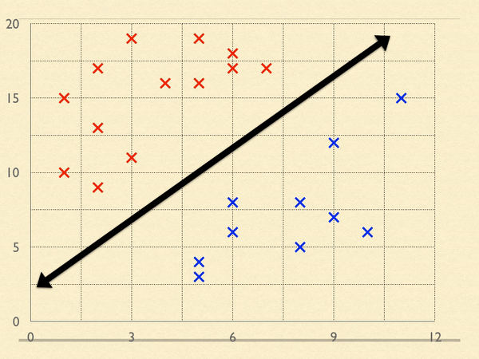
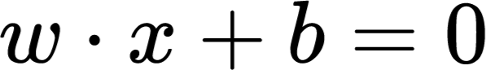
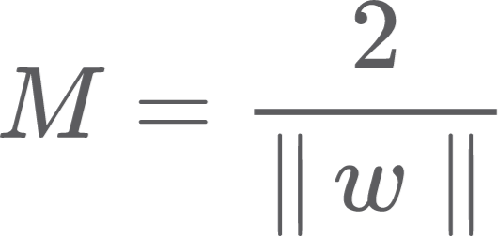
Understanding Support Vector Machines
Strengths - generalizable, adaptable, robustness
Decision Boundary: hyperplane that classifies data based on position relative to its “side” of boundary
x
x
Example feature: Cheek Width
Error Margin: allows some variability without immediately requiring recalibration of model
Support Vectors: “closest” and most relevant data points to calculate decision boundary and margin
Example feature: Jaw Length

Slide 6
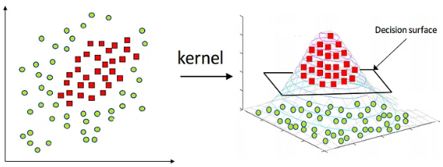
Understanding Support Vector Machines
How SVMs classify non linearly separable datasets (demonstrates capability of analyzing nuances)

Slide 7
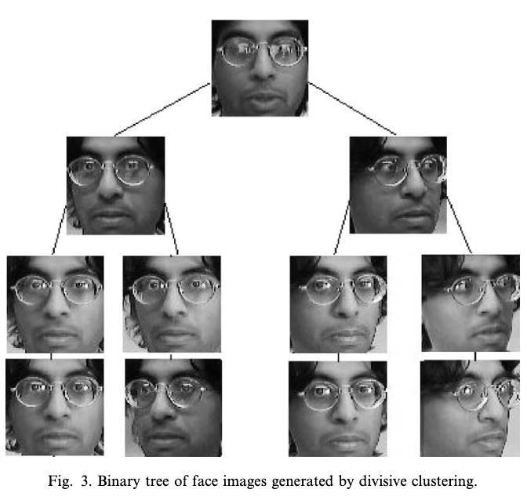
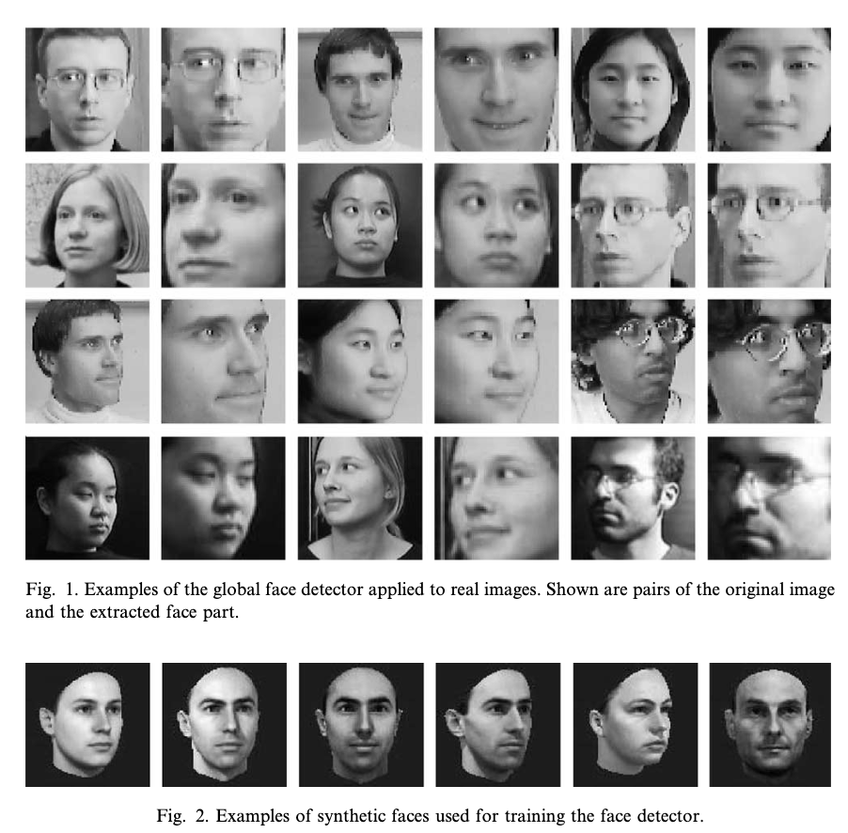
Literature Review: Global vs Component-Based Facial Recognition (using SVMs)
B. Heisele et al. (2003)
Clustering (handles position variance)
Objective - Evaluating robustness of face recognition methods against pose variations
Why this study - Robustness to pose variance helps with unpredictability of intruder’s face orientation
Global Face Recognition Method - Face detected and extracted from images as a single feature vector. - To address face pose variance, group similar poses together during training phase to help system recognize face turned or tilted

Slide 8
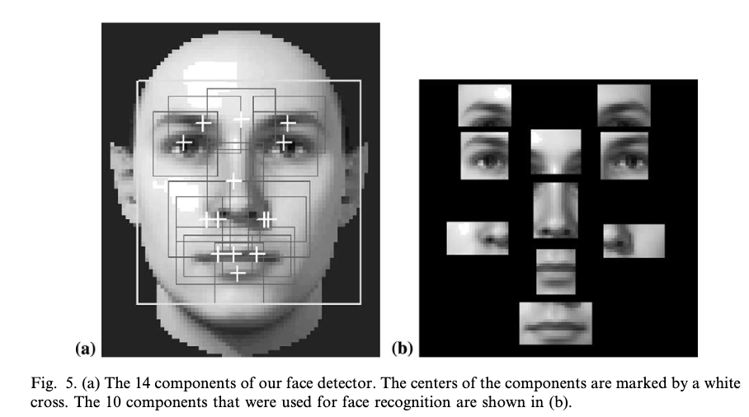
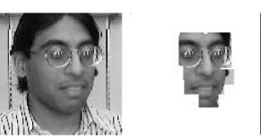
Literature Review: Global vs Component-Based Facial Recognition (using SVMs)
Trained Feature Classifiers (SVMs)
Component-Based Recognition Method - Focus on Features: Examines individual facial features for recognition.
- Pose Flexibility: Provides recognition to different poses by analyzing feature positions.
- Integrated Analysis: Combines feature data for a complete facial profile.
Integrated Analysis
Expert Right-Eye Recognizer
Expert Mouth Recognizer

Slide 9
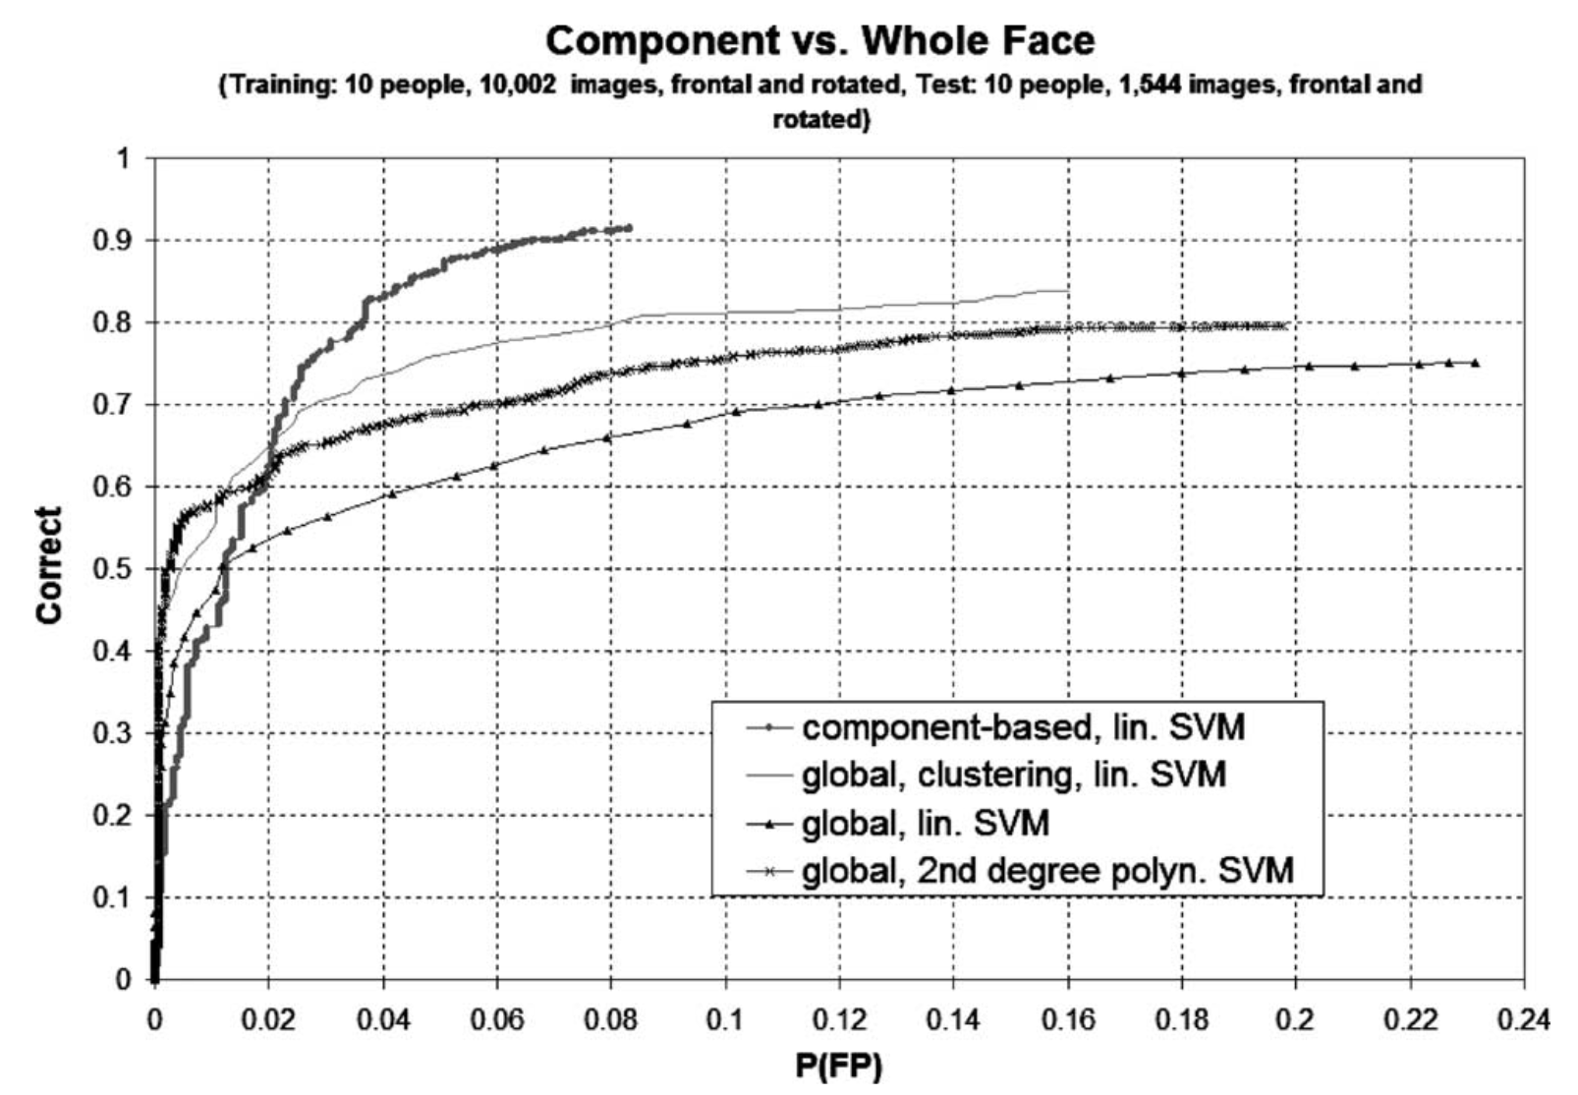
Literature Review: Global vs Component-Based Facial Recognition (using SVMs)
Component-based
Global + clustering
Findings: Method Comparison
- Component approach consistently outperformed global approach at accurately recognizing face despite angle variance
- Global approach with clustering showed improved recognition accuracy for some pose categories, demonstrating robustness
- Influences my project to focus on component-based recognition approach to maximize robustness and reliability
Likelihood of system mistakenly identifying non matching image as a match

Slide 10
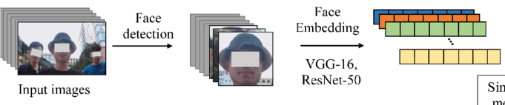


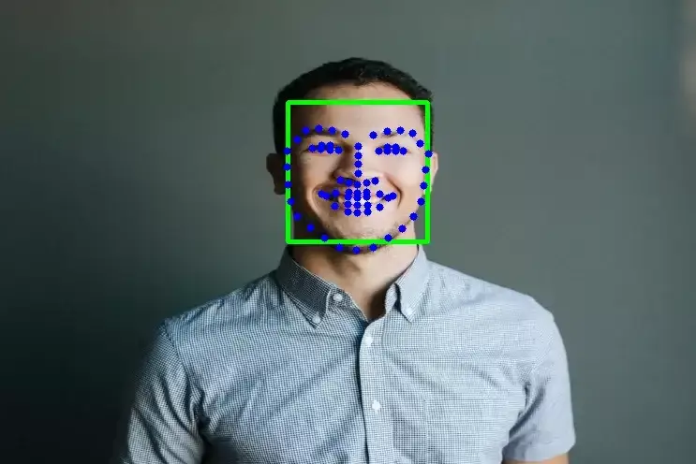
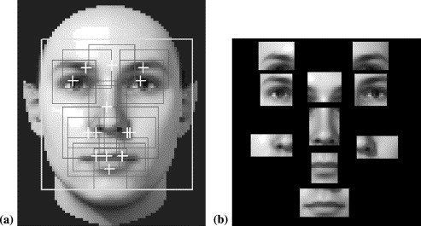
Data Preparation and Preprocessing
Collected 24 videos
(16 to train svms, 8 to test svms)
Loaded Embedding Model: ResNet50
Used Dlib’s front Face detector to identify faces in images
Mapped out facial component ranges of the face for cropping and extracting components

Slide 11
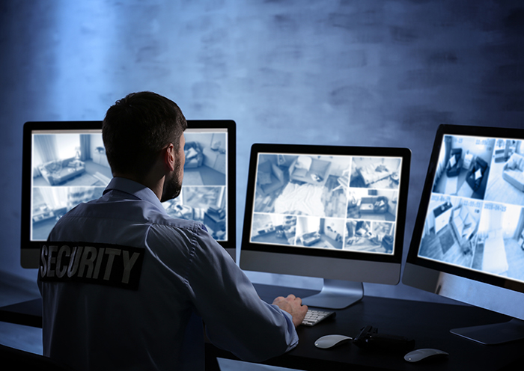
My Plan and Database
Setting up Edge Device:
Take multiple photographs of each individual who should be recognized by the system (different angles)
Store images in directory
Use SVM software to process and create unique digital signature profile for each face
Local database system: SQLite
Cloud Device: google cloud virtual machine
Evaluation:
- Accuracy: confusion matrix to show true positives, false positives, true negatives, false negatives
- Speed comparison: record delay between real-time image capture and display of recognition results
Limitation: relatively small face sample size

Slide 12
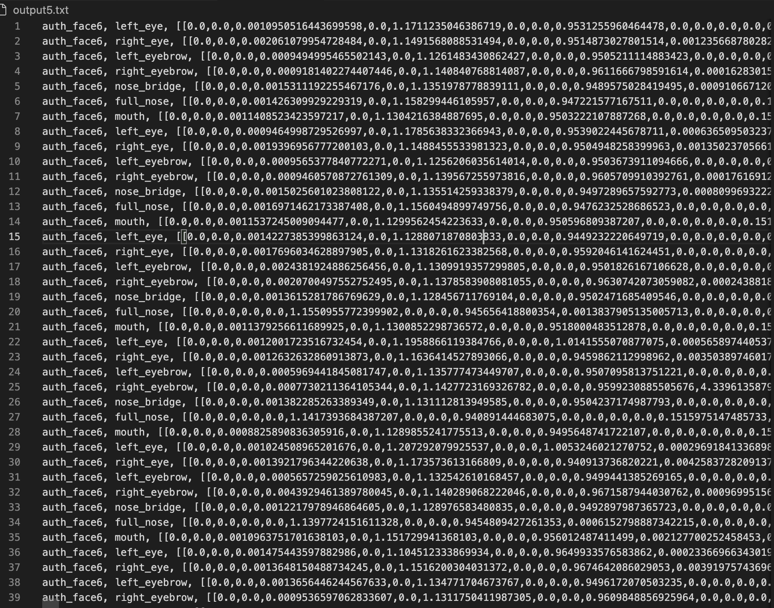
What the data represents
Collected Data:
User Id: Identifies the user to whom the embedding corresponds
Component: Specifies feature (e.g., left_eye, right_eye) that the embedding represents
Embedding: numerical representation of the facial component extracted
Label: '1' for authorized/recognized individuals and '0' for unauthorized/unrecognized

Slide 13
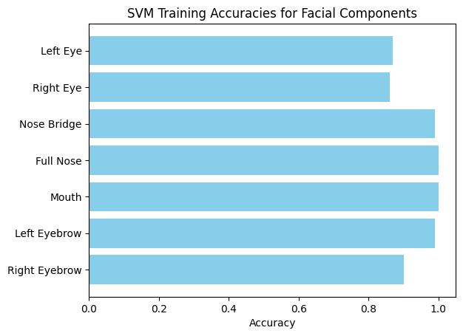
Svm component training data
My Training Results Literature Results
Component-based svms
> Used gridsearch to find best C hyperparameters for each component to train individually.
> C value determines how harshly punished for incorrect prediction
Likelihood of system mistakenly identifying non matching image as a match

Slide 14
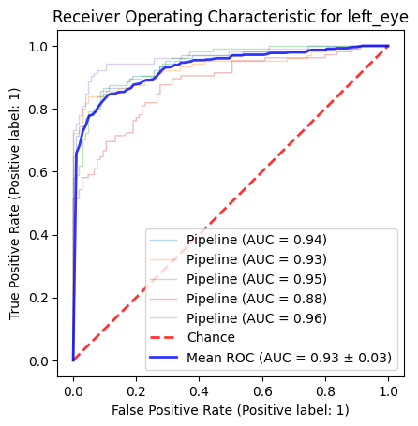
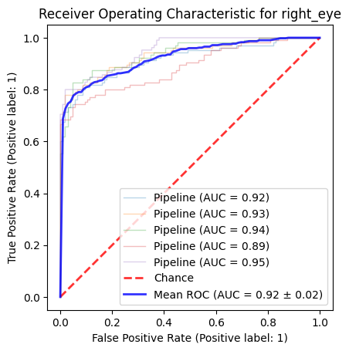
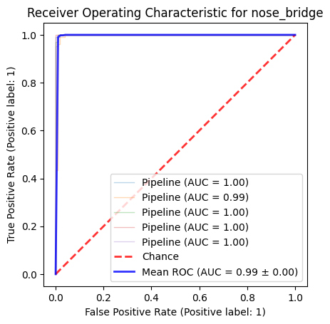
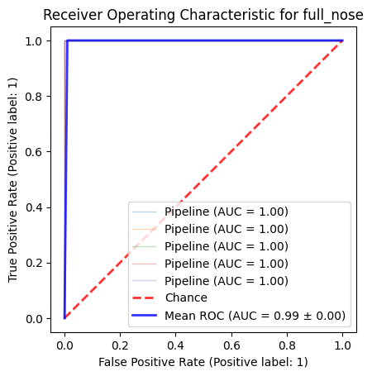
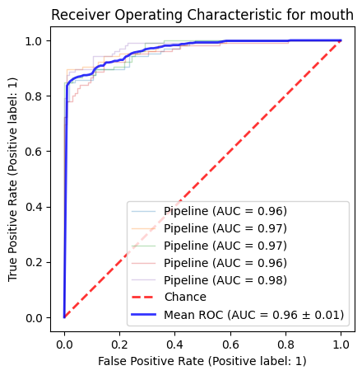


Training validated with ROC Curves
Left eye Right eye Nose Bridge Full nose
Mouth Left eyebrow Right eyebrow
These four components have almost perfect ROC Curves indicating optimal sensitivity with almost no false positives.
(perfect ROC does not always suggest overtrained but rather optimized)

Slide 15
Left eye Right eye Nose Bridge
Full nose
Mouth Left eyebrow Right eyebrow

Slide 16
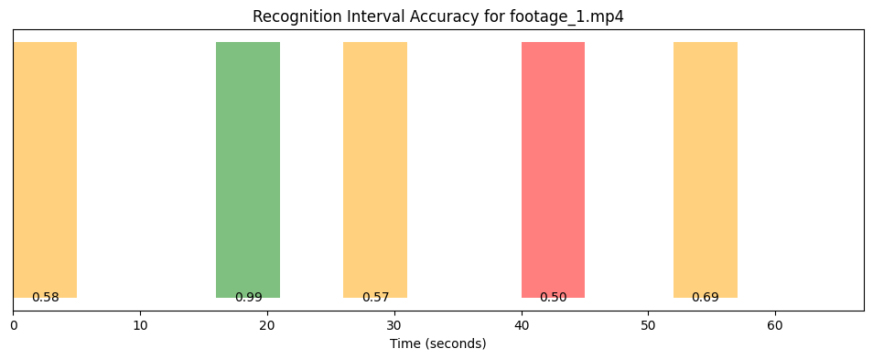
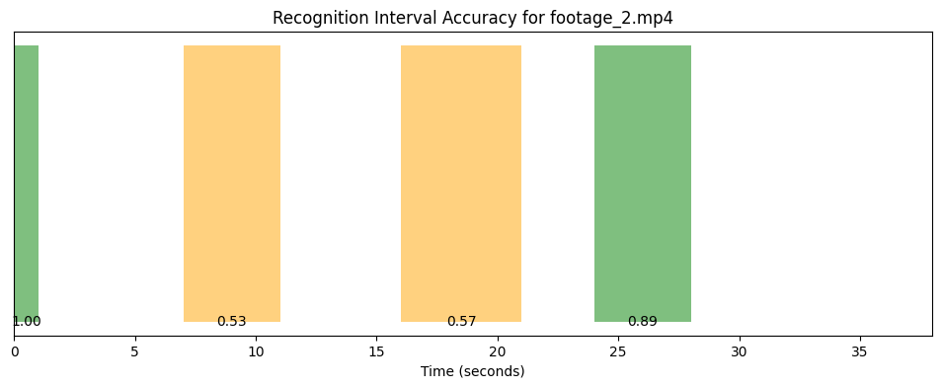
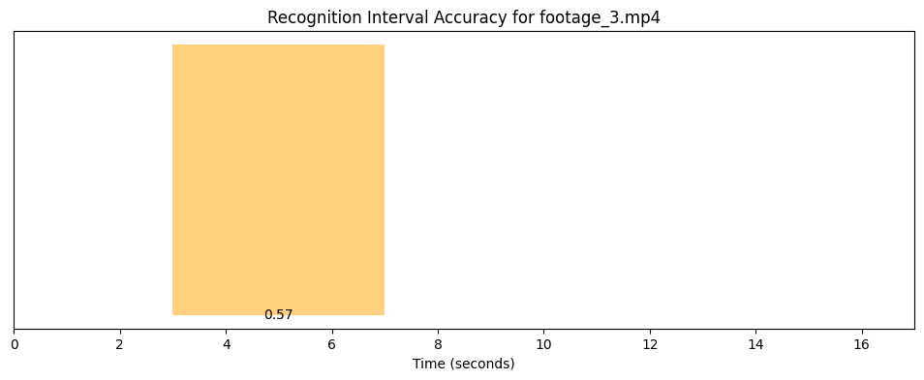
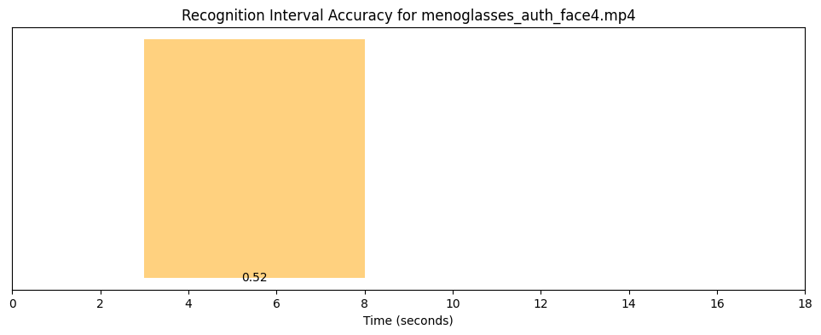
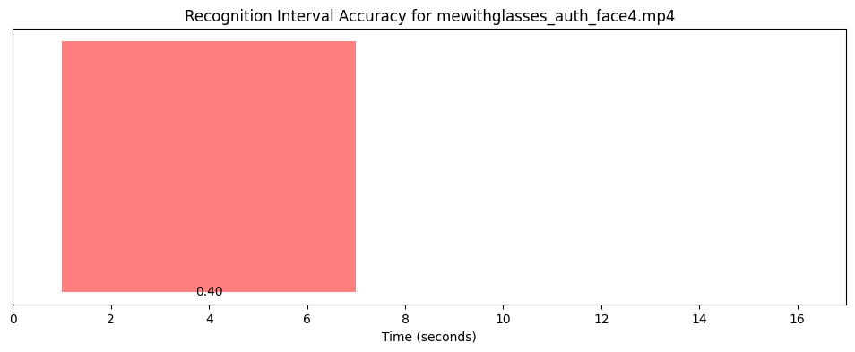
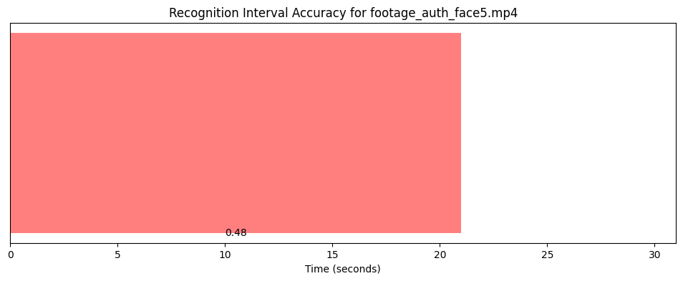
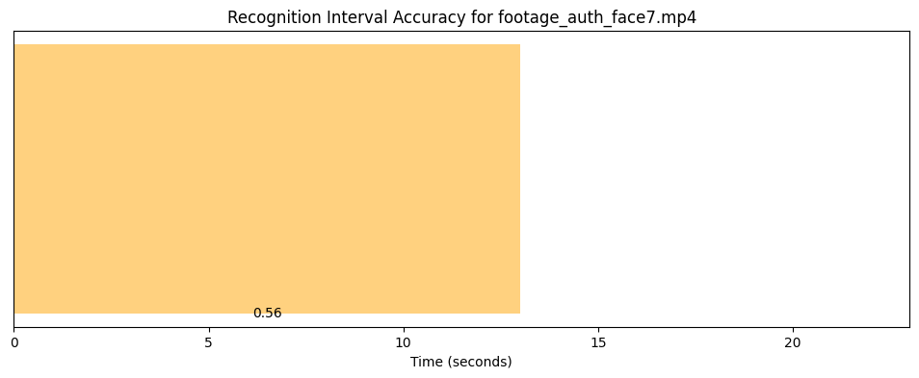
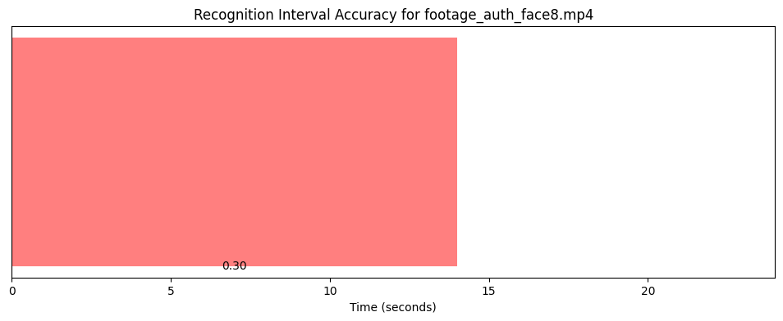

Slide 17
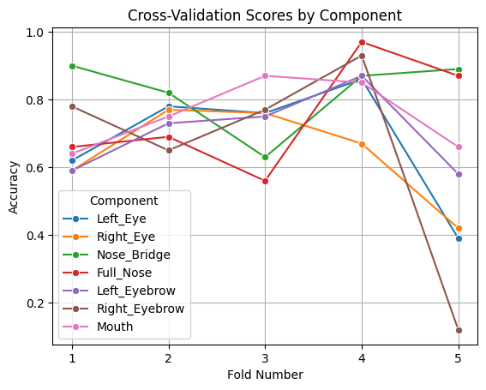
Cross Validation
Average cross-validation score for left_eye: 0.68
Average cross-validation score for right_eye: 0.64
Average cross-validation score for nose_bridge: 0.82
Average cross-validation score for full_nose: 0.75
Average cross-validation score for left_eyebrow: 0.70
Average cross-validation score for right_eyebrow: 0.65
Average cross-validation score for mouth: 0.75
Less accurate averages than training accuracies which suggests overfitting in training data
These accuracies used to calculate decision weights of each component for testing

Slide 18
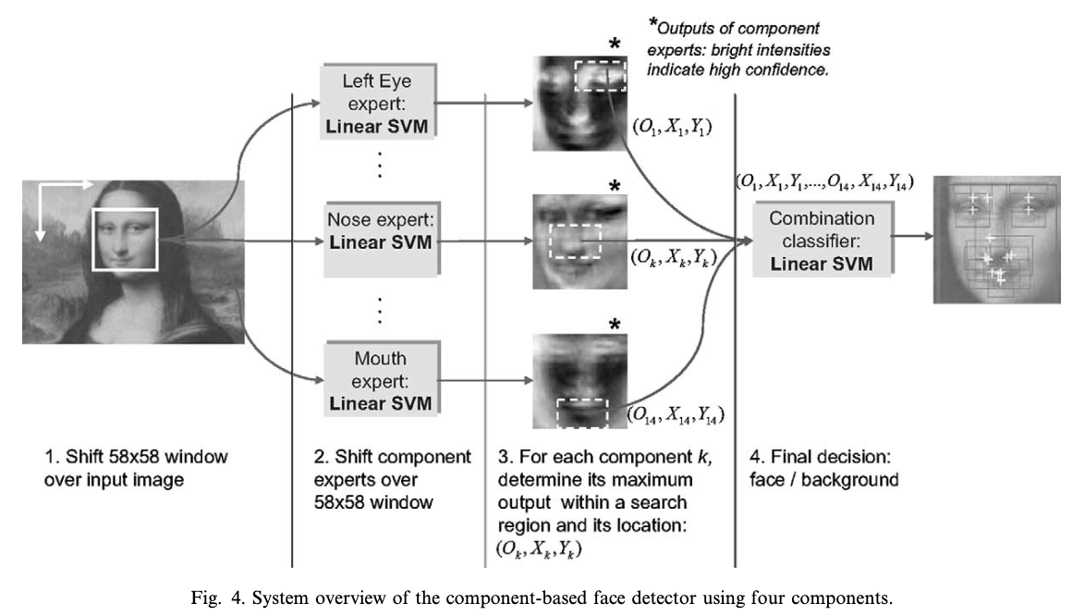
Facial Recognition Logic
Individual predictions contribute to overall confidence score
If score exceeds the set threshold 0.65 of max confidence, the face is recognized
Image preprocessing
to ensure consistent
sampling
My experiment has predefined component landmarks (no shift window)
Scores weighted by historical accuracy of each component.
Diagram Credit :

Slide 19




Testing
Robustness
Determine if authorized faces can be recognized despite lighting and angle variance.
*Diverse ages, races,
Video qualities, lighting,
Facial accessories.*
8 classmate participants
5 celebrity participants
Extract embeddings with clear lighting and varying facial angles
Test with footage of participants not looking at camera

Slide 20
Accuracy
Demonstrates capability for strong recognition with face 1 at 97% accuracy but its not consistent as with faces 6 and 8, they are almost correctly recognized.
Varied results could be due to various conditions of lighting, quality of video, and difficulty of angles to detect accurately. Overall decent accuracy consistency of 60%
Classification Report:
precision recall f1-score support
auth_face8 0.11 0.30 0.16 10
auth_face4 0.91 0.44 0.60 72
auth_face3 0.90 0.56 0.69 381
auth_face7 0.81 0.56 0.66 45
auth_face6 0.00 0.00 0.00 0
auth_face1 0.97 0.58 0.72 210
auth_face2 0.82 0.53 0.64 263
unauthorized 0.37 0.87 0.52 575
auth_face5 1.00 0.48 0.65 936
accuracy 0.60 2492
macro avg 0.65 0.48 0.52 2492
weighted avg 0.81 0.60 0.63 2492
Confusion Matrix:
[[ 3 0 0 0 0 0 0 7 0]
[ 1 32 0 0 2 0 1 36 0]
[ 0 0 214 0 1 2 0 164 0]
[ 0 0 0 25 0 0 0 20 0]
[ 0 0 0 0 0 0 0 0 0]
[ 3 0 18 0 14 121 0 54 0]
[ 2 1 1 2 3 0 139 115 0]
[ 19 2 4 4 17 1 27 500 1]
[ 0 0 2 0 31 1 2 451 449]]

Slide 21
Accuracy
Accuracy in identification varied between
participants walking in and out of frame for footage 1. Suggests more training data is needed to consistently identify diverse faces.
Accuracy decreased by 12% when I tested myself with vs without glasses. Robustness has room for improvement.

Slide 22
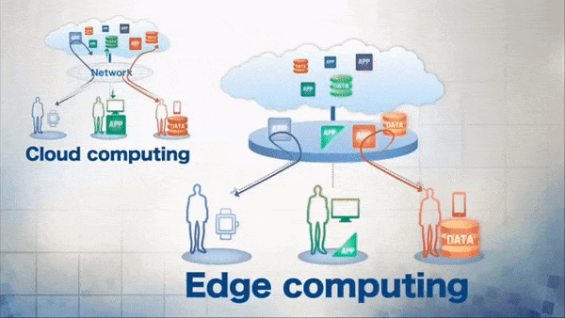
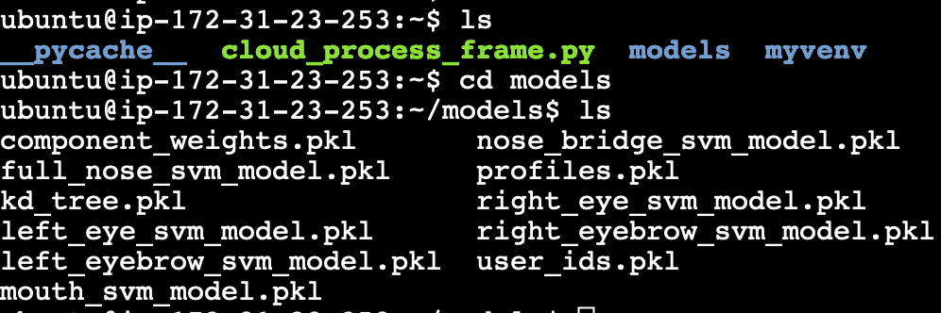

Testing Latency
Latency
Difference in processing speeds when the database is on edge device versus cloud database.
Set up AWS EC2 Cloud instance
Uploaded recognition tools (decision- related functions and trained svms)
Extracted embeddings locally and sent JSON formatted embeddings to server

Slide 23
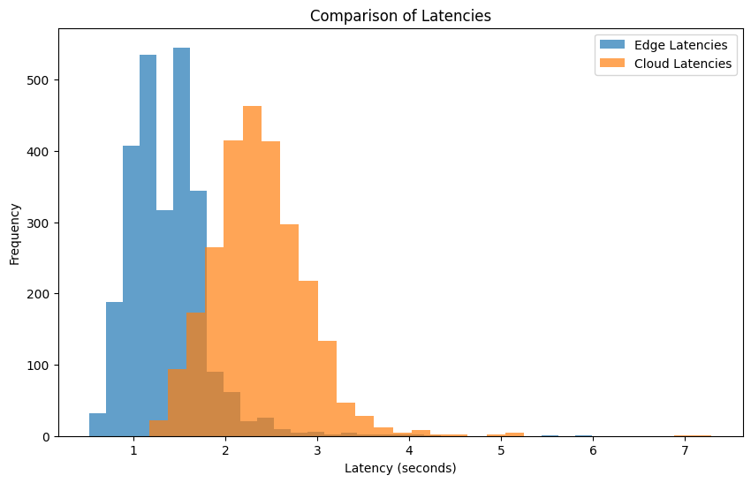
Latency comparison
Tested statistical
Difference with t-test
Edge Summary - Mean Latency: 1.36s, Std Dev: 0.43
Cloud Summary - Mean Latency: 2.37s, Std Dev: 0.52
T-statistic: -76.81, P-value: 0.0000
The difference in latencies is statistically significant.

Slide 24
Conclusions
Hypothesis Support: The data supports the hypothesis that edge computing devices can offer significantly lower latency compared to cloud-based systems, which is advantageous for real-time surveillance.
Considerations for Accuracy: SVMs had decent consistency in accurately predicting whether a person is authorized or unauthorized and if they are authorized, it was decently matching to the correct profile. There is much room for improved robustness against varying faces and video quality.
Exploring more facial components such as jawline, teeth, etc.
Gathering larger database of more faces than 24 videos
Processing speed optimization
Component Based SVM recognition has demonstrated that it can be viable in security in terms of speed (compared to cloud) and accuracy.

Slide 25
Resources
Smart Home Security Systems Market
Edge vs Cloud Efficiency Visual Comparison
Inspiration for Project Design - B. Heisele Et Al 2003
https://github.com/pjmitchell7/cs420_Final

